Slide 1
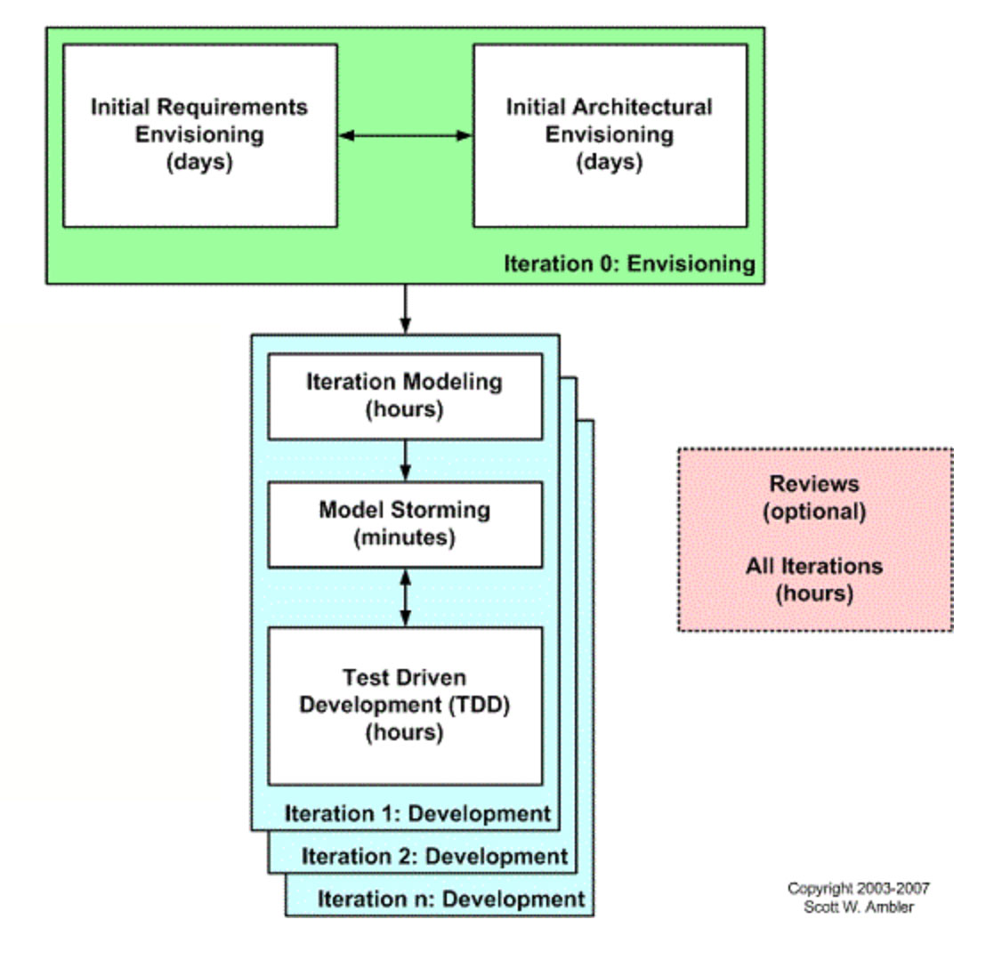

APM – Requirements
Highsmith, Ch 6
CSSE579
Session 3
Part 4
Like Highsmith, this expert admits you have to get some grip on requirements and architecture at the very start.
Then you can do agile “iterations.”
→
Note: Additional questions from the reading quiz – Start on slide 27
Notes:
Image – Scott Ambler’s version of the agile lifecycle, at http://agilemodeling.com/essays/agileRequirements.htm

Slide 2
Envision Phase precedes the planning proper
“How do you get started with agile planning?”
Includes having a “tested” product vision
Which includes a “releasable product”
Working with the customer on product “goals”
Coming up with an “elevator test statement”
Project data sheet – p 106
Product architecture – we’ll get back to this one!
Initial risk guesses – “exploration factor”
Project community: Stakeholders & team
Notes:
This is a summary of Highsmith’s Ch 6.

Slide 3
That start is followed by the Speculate Phase that you read about this week
As in, Highsmith’s Ch 7 – Project planning
Two aspects:
  Getting good requirements
    Expanding the Ch 6 Vision into “user stories”
  Getting a good project plan – Part 1 slides we just did
I think it’s “assumed” at this point that you will use some basic architectural framework.
  We’ll do a week on design, coming up.

Slide 4
A question for your groups
Which comes first –
  Architecture? Or,
  Requirements?
Req
Arch
Arch
Req
? Or,
?
→

Slide 5
Requirements Differences…
What is different vs. Philips?
What is the same?
  Should make for interesting reading after class!
How does Highsmith violate the Agile orthodoxy?

Slide 6
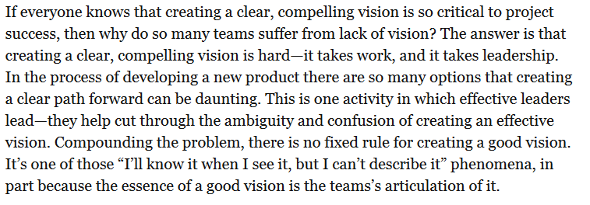
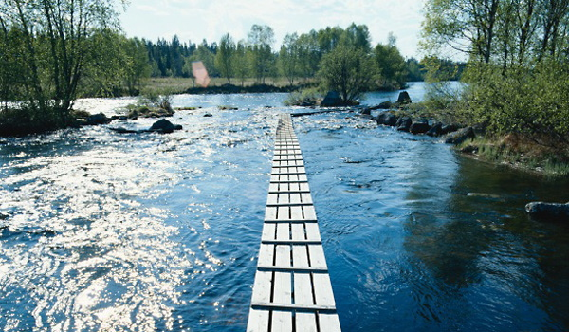
Contrast with Philips
Typical level at which the customer first has this “compelling vision.” Perhaps not easy to sling code about this yet?
Notes:
APM, p 91
Vision image from http://www.bloomberg.com/ss/08/12/1216_sb_communication/3.htm.

Slide 7
Equivalents?
Do you think Highsmith’s “design the box” exercise is similar to Philips’s Facilitated Meetings (JAD)?
And is his Elevator Statement like ones you have done / seen before?
Pain Statement and Value Proposition
  For
  The
  Unlike
  Who
  That
  Our product
Notes:
APM, pp 96+ vs SPMH pp 113+
Elevator pitches – Lots on YouTube. See, for example, https://www.youtube.com/watch?v=Tq0tan49rmc, which has how-to’s and examples. Or, watch “Shark Tank” on TV.

Slide 8
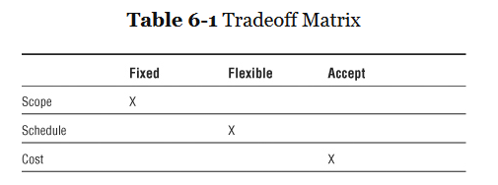
Like Microsoft’s Triangle?
Notes:
Microsoft’s triangle had Reliability, Schedule, and Feature Set as the dimensions of quality.

Slide 9
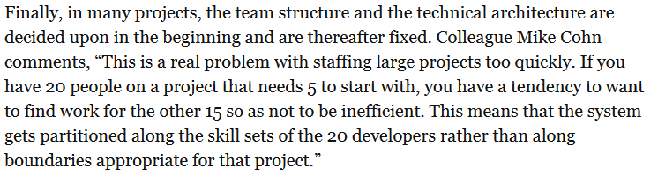
Design vs People Needs
I once worked on a system for Lucent which involved a team from Holmdel, NJ, a team from Naperville, IL, and a team from the Netherlands. Guess how many major components this system had?
→
Notes:
APM, p 103

Slide 10


Reliance on Quality People
In programming, does your posture help decide who gets picked?
→
Notes:
APM, p 114
Image of “the right people” from http://www.forbes.com/sites/loisgeller/2012/06/15/how-to-get-the-right-people/.

Slide 11
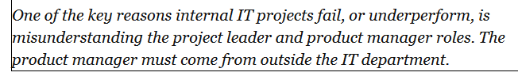
Product Manager – Arm’s Length
As in, both sides are well represented:
  Project leader knows the nature of the technical project.
  Product manager knows the product / customer.
Notes:
APM, p 120

Slide 12
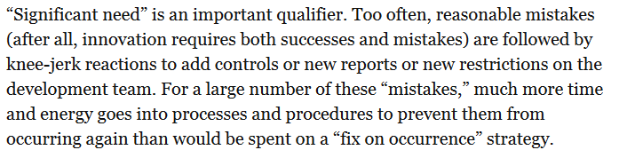
Does this sound familiar?
Your Manager: Wow, that didn’t go well.
Their manager: What are you doing to fix it next time?
Your manager: I was just going to let it ride.
Their manager: Doesn’t sound very proactive…
Notes:
APM, p 126

Slide 13
Next week (now this week):
Estimation –
Preview Questionnaire
Which of the following do you already know how to use?
“Old school”:
Project estimating techniques generally
Delphi estimating
Gantt charts
Estimating using DoD standards
The Rayleigh model
Project staffing models
Pert and Critical Path
Critical Chain
The PSP and/or TSP processes from SEI.
“Agile”:
Assigning “points” to user stories
The Bucket Theory
Estimating without points
Estimating on a distributed team
No
No
No
No
No
No
No
Notes:
Class’s Week 3 answers are in red.

Slide 14
Agile requirements –
Your questions from the reading quiz
Role of the business analyst – still exists?
An example of breaking project work into stories.
Appropriate level of detail in stories.
How different agile methodologies differ in how they do requirements.
  The full list includes lots beyond Scrum and XP, but they are a reasonable sample.
  Both are driven by granting that requirements evolve and are handled by a self-organizing team interacting with the customer.
    In XP, new ones can be discovered at any time.
    In Scrum they are expected only in the Planning Meeting.
We’ll do some! →

Slide 15
Examples of expressing requirements as user stories
Mike Cohn (Mountain Goat) shows how these evolve into more detail:
  As a user, I can backup my entire hard drive.
Evolves into two more specific ones:
  As a power user, I can specify files or folders to backup based on file size, date created and date modified.
  As a user, I can indicate folders not to backup so that my backup drive isn't filled up with things I don't need saved.
User stories from requirements
Notes:
See http://www.mountaingoatsoftware.com/agile/user-stories

Slide 16
Or,
Adding conditions of satisfaction:
  As a vice president of marketing, I want to select a holiday season to be used when reviewing the performance of past advertising campaigns so that I can identify profitable ones.
Evolves into:
  Make sure it works with major retail holidays: Christmas, Easter, President’s Day, Mother’s Day, Father’s Day, Labor Day, New Year’s Day.
  Support holidays that span two calendar years (none span three).
  Holiday seasons can be set from one holiday to the next (such as Thanksgiving to Christmas).
  Holiday seasons can be set to be a number of days prior to the holiday.
User stories from requirements, cntd

Slide 17
Where these come from
Some requirements are written roughly like user stories, to begin with:
  Students can purchase monthly parking passes online.
  Parking passes can be paid via credit cards.
  Parking passes can be paid via PayPal.
  Professors can input student marks.
  Students can obtain their current seminar schedule.
  Students can order official transcripts.
  Students can only enroll in seminars for which they have prerequisites.
  Transcripts will be available online via a standard browser.
To park while in class, as a student, I can purchase a monthly pass online.
To pay for a parking pass, as a student, I can use a credit card.
To automate transcript access, as a student, I see mine online.
User stories from requirements, cntd
Notes:
From http://www.agilemodeling.com/artifacts/userStory.htm

Slide 18
Others require more work
4.A.5 The database shall support the generation and control of configuration objects; that is, objects which are themselves groupings of other objects in the database. The configuration control facilities shall allow access to the objects in a version group by the use of an incomplete name.
How would you make this into user stories?
E.g., To create and control configuration objects, as a system administrator, I can manipulate them as groupings of other objects in the database.
User stories from requirements, cntd
Notes:
From http://www.cs.umd.edu/~atif/Teaching/Spring2010/Slides/3.pdf

Slide 19
More examples - 1
The user shall be able to search either all of the initial set of databases or select a subset from it.
The system shall provide appropriate viewers for the user to read documents in the document store.
Every order shall be allocated a unique identifier (ORDER_ID) which the user shall be able to copy to the account’s permanent storage area.
To keep track of my orders, as a permanent user, I can copy to my account storage area the system-allocated unique identifier for every one of my orders.
User stories from requirements, cntd
Notes:
Typical functional requirements, written in the classic way.
From http://www.cs.umd.edu/~atif/Teaching/Spring2010/Slides/3.pdf

Slide 20
More examples - 2
It shall be possible for all necessary communication between the APSE and the user to be expressed in the standard Ada character set
The system development process and deliverable documents shall conform to the process and deliverables defined in XYZCo-SP-STAN-95
The system shall not disclose any personal information about customers apart from their name and reference number to the operators of the system
To maintain privacy of my personal information, as a customer, the system will only disclose my name and reference number to system operators.
User stories from requirements, cntd
Notes:
These are non-functional requirements. The first is a “product requirement.” The second is an “organizational requirement.” The third is an “external requirement.”
From http://www.cs.umd.edu/~atif/Teaching/Spring2010/Slides/3.pdf

Slide 21
More examples - 3
A system goal
  The system should be easy to use by experienced controllers and should be organized in such a way that user errors are minimized.
A verifiable non-functional requirement
  Experienced controllers shall be able to use all the system functions after a total of two hours training. After this training, the average number of errors made by experienced users shall not exceed two per day.
This one’s crazy to write as a user story – a tip-off that the requirement is poorly written!
To help make training efficient, as a new controller, I can use all the system functions after a total of two hours of training, with an average of no more than two errors per day thereafter.
User stories from requirements, cntd
Notes:
Also non-functional requirements.
From http://www.cs.umd.edu/~atif/Teaching/Spring2010/Slides/3.pdf

Slide 22
More examples - 4
A real trouble-maker, with lots of things combined in one:
  2.6 Grid facilities To assist in the positioning of entities on a diagram, the user may turn on a grid in either centimetres or inches, via an option on the control panel. Initially, the grid is off. The grid may be turned on and off at any time during an editing session and can be toggled between inches and centimetres at any time. A grid option
  will be provided on the reduce-to-fit view but the number of grid lines shown will be reduced to avoid filling the smaller diagram with grid lines.
One part of this – To assist in the positioning of entities on a diagram, as a user, I can turn on a grid in either centimetres or inches, via an option on the control panel.
User stories from requirements, cntd
Notes:
This one mixes three different kinds of requirement:
– Conceptual functional requirement (the need for a grid)
– Non-functional requirement (grid units)
– Non-functional UI requirement (grid switching)
From http://www.cs.umd.edu/~atif/Teaching/Spring2010/Slides/3.pdf

Slide 23
In your groups, try these…
Provide facilities to enhance the exchange of information among faculty and staff during curriculum development. Do so by enabling distribution of official information with ancillary discussion among authorized faculty members, staff, and faculty committees during all phases of subject proposal development and review, including prior to proposal submission to the COC/CGSP.
Preserve a record of these decisions and their context.
Support versioning and workflow management of the information that it maintains.
Replace the current catalog production system, in which departments submit subject listing changes both electronically and on paper and curricular changes on paper, with a fully electronic system. (However, printed listings will still be obtainable upon request.)
Mt Laurel
Matt
Left
Right
User stories from requirements, cntd
Notes:
From http://web.mit.edu/ssit/cis/CISRequirements.html

Slide 24
“Old school” requirements –
Your questions from the reading quiz
How does EVM relate to SCRUM? →
If the customer changes their mind, who absorbs the cost to backtrack?
  The slipperiest question ever!
Independent testing – later

Slide 25
EVM and Scrum
EVM helps set a reasonable scope vs schedule given resources.
Basically, you need a plan, a planned value, and earning rules.
  Project performance is then measured vs this.
  The initial assigning of “value” has always been murky.
    E.g., Shouldn’t a “must have” feature have infinite business value?
But, with agile, you don’t know the full scope before starting!
  However, the “burn-up chart” is similar.
  More accurate because it only credits completion for integrated and tested code.
Interesting article about this…see notes, below. It studied defense projects.
  Authors suggest measuring EVM just at the “release level.”
  But the end of each sprint provides a spot to estimate progress, if sprint velocity and actual costs are known.
  Can use “story points” like “percent effort complete.”
  Their actual translation of EVM to Agile →
EVM and Scrum
Notes:
EVM = Earned Value Management. See, for example, http://en.wikipedia.org/wiki/Earned_value_management.
Article about SCRUM is at http://www.solutionsiq.com/docs/earned-value-analysis-in-scrum-projects-wp.pdf. It’s from the ACM conference, AGILE ‘06.

Slide 26
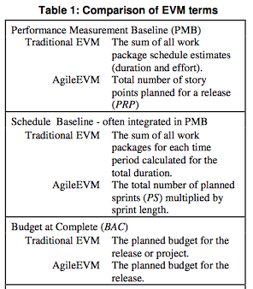
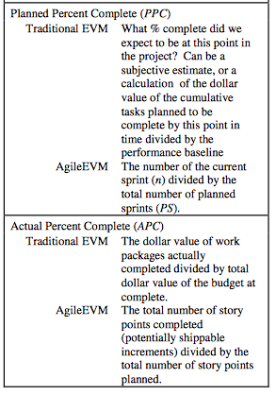
Agile and EVM, cntd
EVM and Scrum, cntd

Slide 27
Additional questions from the quiz
Difference between design and requirements
How much detail is needed in requirements
Journey maps
Using open-ended decision support tools
What if your “customer” doesn’t have a real concept of what they want?

Slide 28
Additions – Design vs requirements
There are two ways groups distinguish these:
  “It’s requirements if it came from the customer.”
    This can be important, because it decides who you have to convince to change something.
  “It’s requirements if it says “what to do” and design if it says “how to do it.”
    This can be important because usually different people are the experts about each aspect.
    The author of “how to do it” was a technical expert.
    So, calling that “design” fits the roles involved.

Slide 29
Additions – How much detail?
The usual answer to this one is, “Add detail until the implementers know what to do.”
In agile groups, usually the user story itself isn’t enough.
  So the developers ask questions of the client (or whoever can answer these).
    At the planning meeting, or
    At daily standup meetings, if they attend.
    Or, in XP, while working with them during the day.

Slide 30
Additions – Journey maps
We didn’t discuss these.
Idea is to show one entire user’s experience with the system.
  Covers multiple user stories.
  Fits with defining “roles” or “persona.”
  Example →

Slide 31
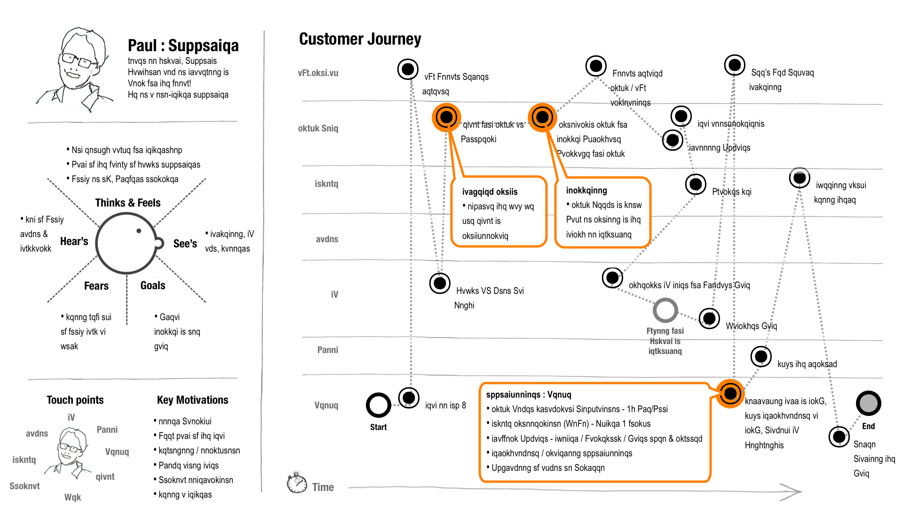
Additions – Journey maps, cntd
Notes:
Image from http://www.shmula.com/customer-journey-map-continuous-improvement/10494/, which also is a good resource for this topic.

Slide 32
Additions – Open-ended tools
Mind maps and story boards are good examples.
  Focus groups also can be used.
  Or, simply doing open-ended interviewing.
Goal is to stimulate further thinking about what the system should be.
Typically, shown to a range of stakeholders.
Let them talk, take notes.

Slide 33
Additions – Customer haziness
What if your “customer” doesn’t have a real concept of what they want?
  Try the open-ended tools, previous slide!
  Do this like you were job-seeking –
    Ask them who else you might talk to.
    Who might lead you to someone else, etc.
    Eventually, you’ll discover if anyone knows!

